Slide 1
red-black trees
CS340

Slide 2
Red-Black Trees
Red Black Trees are a kind of Binary Search Tree that are balanced
guarantee of logarithmic height O(lg n)
Non-modifying binary-search-tree operations MINIMUM, MAXIMUM, SUCCESSOR, PREDECESSOR, and SEARCH run in O(lg n) time on red-black trees.
INSERT and DELETE are tricky! Must maintain red-black tree properties.
R-B Trees have an extra bit of information at each node
the color: Red? or Black?

Slide 3
Red-Black Tree Properties
3
Every node is either red or black.
The root is black.
Every leaf is NIL and black.
If a node is red then both its children are black.
For each node, all simple paths to its descendant leaves have the same number of black nodes.
This number defines the black height of a node x, bh(x).
By the previous property, bh(x) ≥ h(x)/2

Slide 4
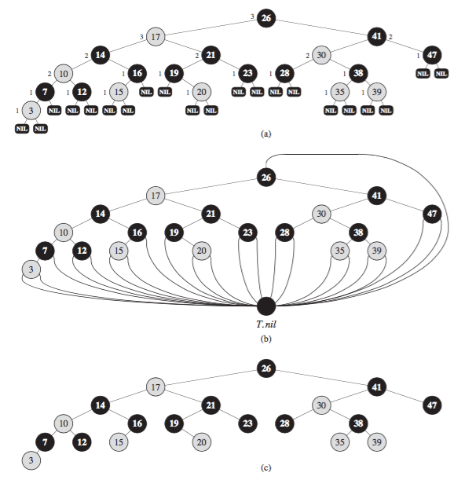
4

Slide 5
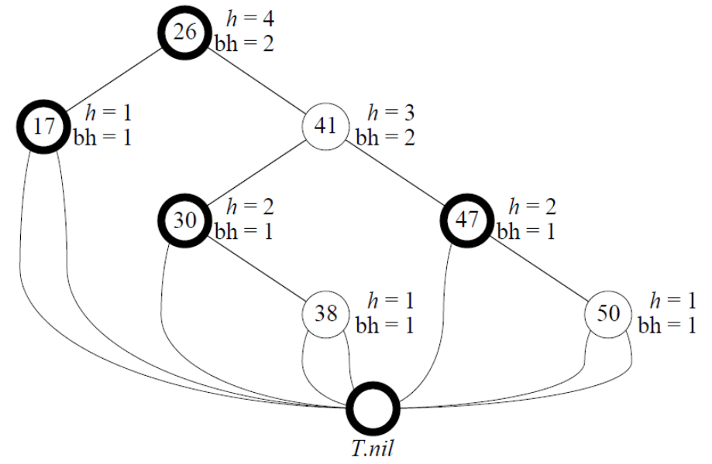
Height and Black Height
5
Height: number of edges in longest path to a leaf
Black Height: number of black nodes (including T.nil) on the path from x to leaf, not counting x (see property 5)

Slide 6
Red-black tree properties
6
Any node with height h has black-height, bh(x) ≥ h/2.
Proof
Property 4: If a node is red then both its children are black.
This means that each red node must be followed by a black node. The reverse is not necessarily true.
Therefore, ≤ h/2 nodes on the path from the node to a leaf are red. Hence ≥ h/2 nodes are black.

Slide 7
Let’s show: T(x) ≥ 2^{bh(x)} -1
7
The subtree rooted at any node x has ≥ 2^{bh(x)} -1 internal nodes
We prove by induction on the height, namely h(x).
Base: When h(x) == 0, x must be a leaf, thus having 0 black height and 1 = T(x).
Note: 1 ≥ 2⁰-1 = 1-1 = 0 is true.
Inductive case: For h(x) > 0, x must be an internal node with 2 children, say y and z. bh(y) and bh(z) are either bh(x) (child is red) or bh(x)-1 (child is black). Either way, their height is h(x)-1, so apply the inductive hypothesis on both y and z:
T(y) ≥ 2^{bh(x)-1} -1, and T(z) ≥ 2^{bh(x)-1} -1
T(x) = T(y)+T(z) + 1 ≥ 2^{bh(x)-1} -1 + 2^{bh(x)-1} -1 + 1 // 2 child trees + node x
= 2(2^{bh(x)-1} -1) + 1 ≥ 2^{bh(x)} -1

Slide 8
R-B Tree height ≤ 2 lg(n+1)
8
T(x) ≥ 2^{bh(x)} -1 (shown previously).
Recall that bh(x) ≥ h(x)/2 so that
T(x) ≥ 2^{h(x)/2} -1
Therefore, taking x to be the root r, so that T(r) = n, we get
n ≥ 2^{h(x)/2} -1 which implies that 2^{h(x)/2} ≤ n+1 so that
Taking logs on both sides, h(x) ≤ 2 log(n+1).

Slide 9
Interview Questions
9
Draw the complete binary search tree of height 3 on the keys {1,2,…,15}. Add the NIL leaves and color the nodes in three different ways such that the black-heights of the resulting red-black trees are 2, 3, and 4.

Slide 10
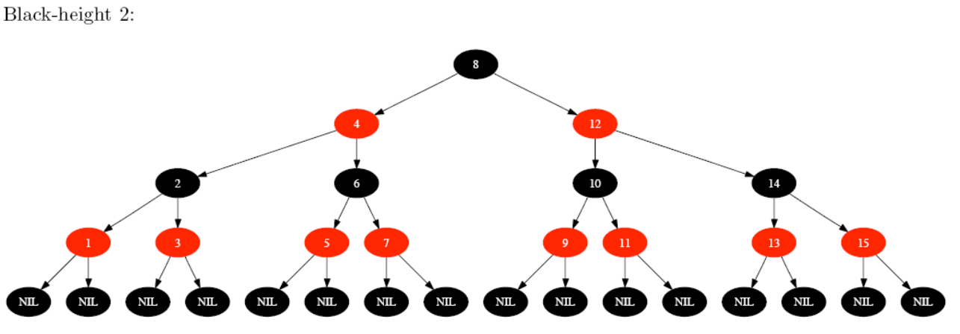
Solution
10

Slide 11

Interview Questions
11
Draw the red-black tree that results after TREE-INSERT is called on the tree below with key 36. If the inserted node is colored red, is the resulting tree a red-black tree? What if it is colored black?
continued →

Slide 12
Interview Questions
12
Show that the longest simple path from a node x in a red-black tree to a descendant leaf has length at most twice that of the shortest simple path from node x to a descendant leaf.

Slide 13
Rotations of trees
9
Rotation to change shape
One side gets taller, the other shrinks
6
11
3
8
10
1
5
7
2
6
6
3
8
9
3
9
1
5
7
11
1
5
8
11
2
10
2
7
10

Slide 14
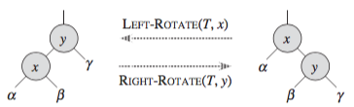
Rotation of Trees
14
Maintaining Red-Black tree properties upon insertion involves rotations
Left-Rotate:
right child is not T.NIL.
y is new root.
x is y's left child.
y's left child is x's right child.
Rotation maintains inorder ordering of keys.
What happens to the relative subtree heights?

Slide 15
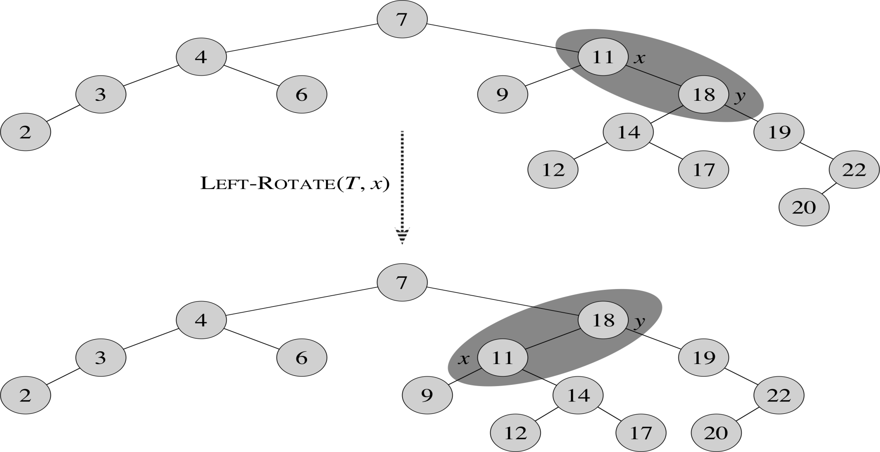
15

Slide 16

Rotations
16
Before rotation: keys of x’s left subtree ≤ 11≤ keys of y’s left subtree ≤ 18 ≤ keys of y’s right subtree.
Rotation makes y’s left subtree into x’s right subtree.
After rotation: keys of x’s left subtree ≤11 ≤keys of x’s right subtree ≤18≤ keys of y’s right subtree.
Rotation is done by changing pointers. Time complexity = ??
Notes:
O(1) time complexity since a constant number of pointers is changed

Slide 17
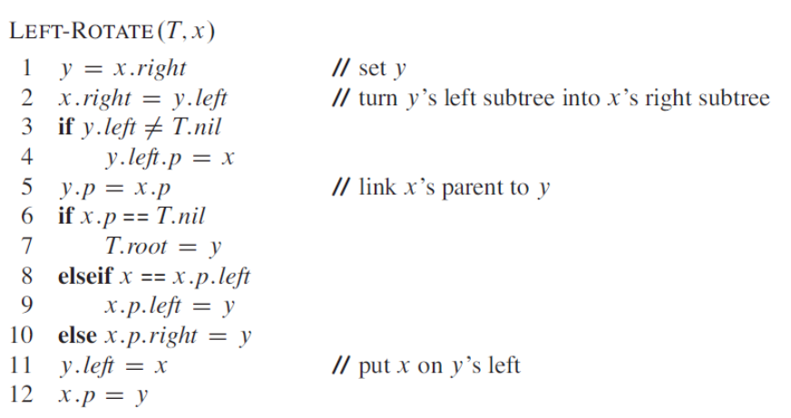
Left-Rotate
17
Time complexity?
Notes:
O(1) complexity

Slide 18
Interview Questions
18
Write pseudocode for RIGHT-ROTATE.
Argue that in every n-node binary search tree, there are exactly n - 1 possible rotations.

Slide 19
Insertion and deletion
19
Search, Min, Max, Successor, Predecessor are the same as with binary search tree.
If we insert, what color to make the new node?
Red? Might violate property 4. (if node is red, both children are black)
Black? Might violate property 5 (all paths to descendants have same number of black nodes)
If we delete, what color was the node that was removed?
Red? OK, since we won’t have changed any black-heights, nor will we have created two red nodes in a row.
Black? Could cause there to be two reds in a row (violating property 4), and can also cause a violation of property 5. Could also cause a violation of property 2 (root is black), if the removed node was the root and its child—which becomes the new root—was red.

Slide 20
R-B Insertion
20
First, insert the new value as a red leaf into the R-B tree just like a BST.
RB-Insert(T,z)
This may cause a red-red violation or a red root violation, thus needing to be fixed.
RB-Insert-Fixup(T,z)

Slide 21
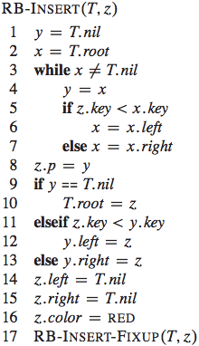
Lines 3-7 search for the
correct leaf position.
Note that nil is
not the same as
NULL.
Remember that the newly
inserted node z is first
colored red.
What are 4 differences
between Tree-Insert and
RB-Insert?
Notes:
1. NIL in Tree-Insert is replaced by T.NIL in RB-Insert
2. z.left and z.right are set to T.NIL
3. Node is colored red
4. Fixup method must be called

Slide 22
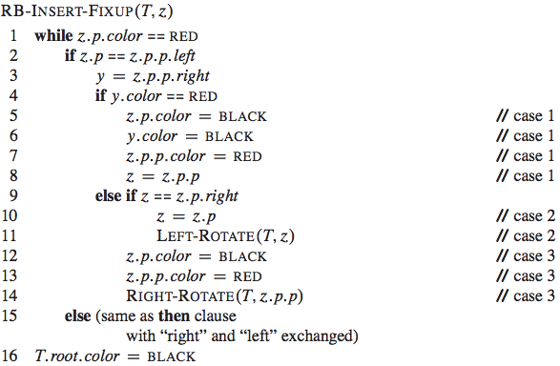
Unfortunately, the Fixup is more complicated!
Note that y is
the UNCLE of z.
if red uncle
color parent black
color uncle black
color grandparent red
move problem to gp
if right child with black uncle
move problem up to parent
rotate on parent node
z is a left child with black uncle
change parent & gp colors
rotate right

Slide 23
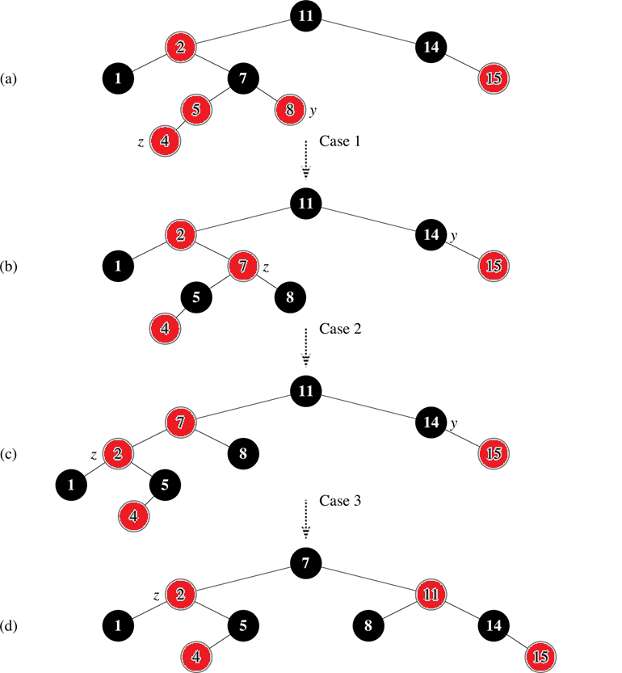
Case 1: If red uncle,
Re-color above generations.
Also, move problem to gp.
Note that y is z's uncle
Case 2: Black uncle and
Zig-Zagging (z is a right child and z's parent is a left child):
Move problem to parent.
Rotate on parent to remove
zig-zag
Case 3: Black uncle
Without zig-zag
(z is a left child and z's parent is a left child):
Recolor parent to black and gp to red.
Rotate on gp to balance
Terminal Case!

Slide 24
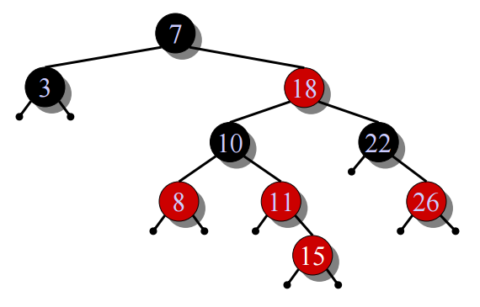
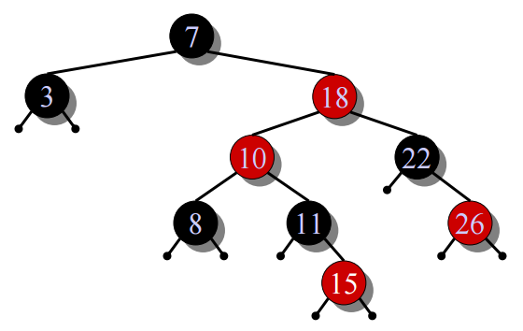




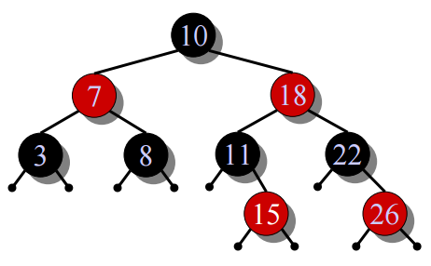
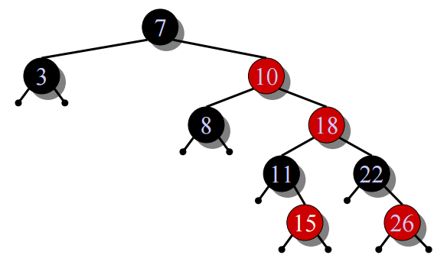
Another Example: Insert 15
24
Case 1
Case 2
Case 3

Slide 25
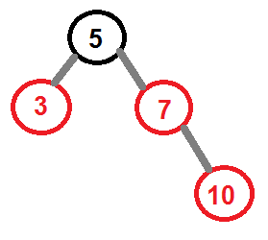
Say 10 is inserted
25
What case is this?
What is the resulting tree
After the fix-up procedure?
Notes:
Case1, red uncle
Uncle (3) is red, so color parent (7) black
color uncle (3) black
color grandparent (5) red
move problem to gp
The root is now red, so color it black

Slide 26
Interview Questions
Why is a new node set to red and not black?
Show the red-black trees that result after successively inserting the keys 41, 38, 31, 12, 19, 8 into an initially empty red-black tree.

Slide 27
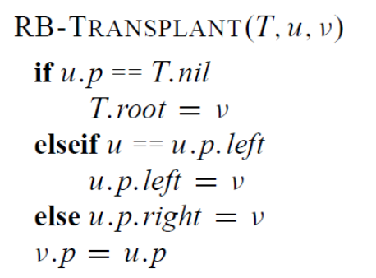
Delete a node
How does it differ from BST Transplant?
Notes:
RB-TRANSPLANT references the sentinel T:nil instead of NIL.
Assignment to v.p occurs even if points to the sentinel. In fact, we exploit the
ability to assign to v.p when v points to the sentinel.

Slide 28
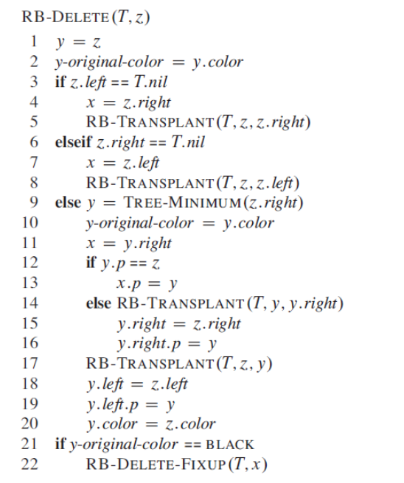
Delete a node

Slide 29
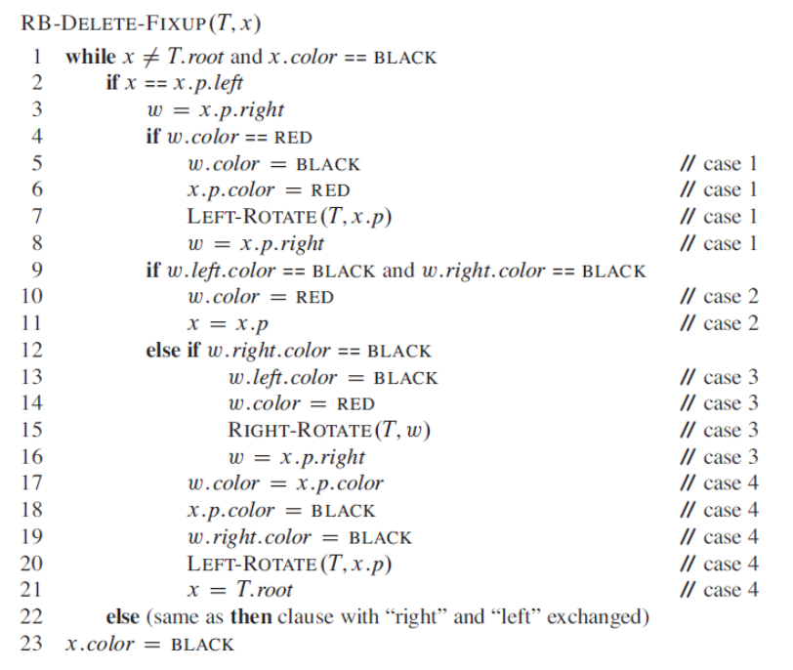
Fixup

Slide 30
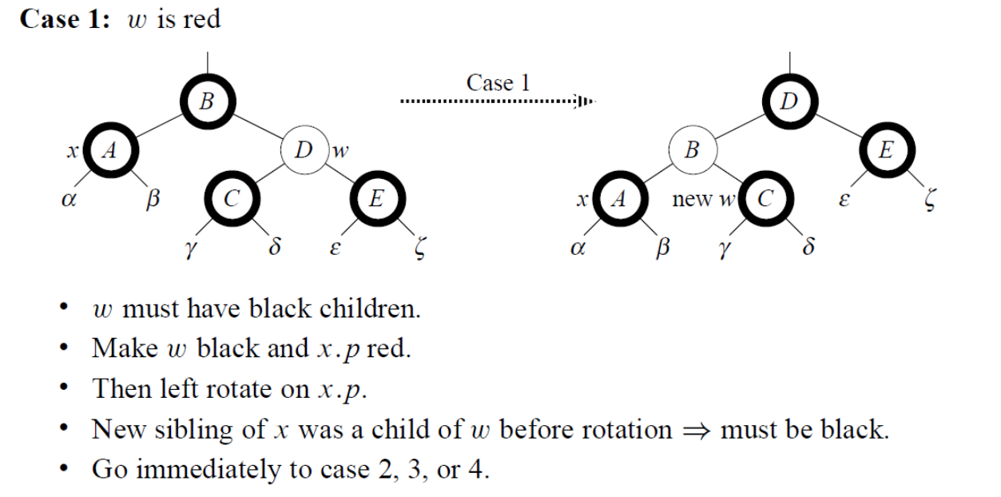
Case 1: Sibling is red

Slide 31
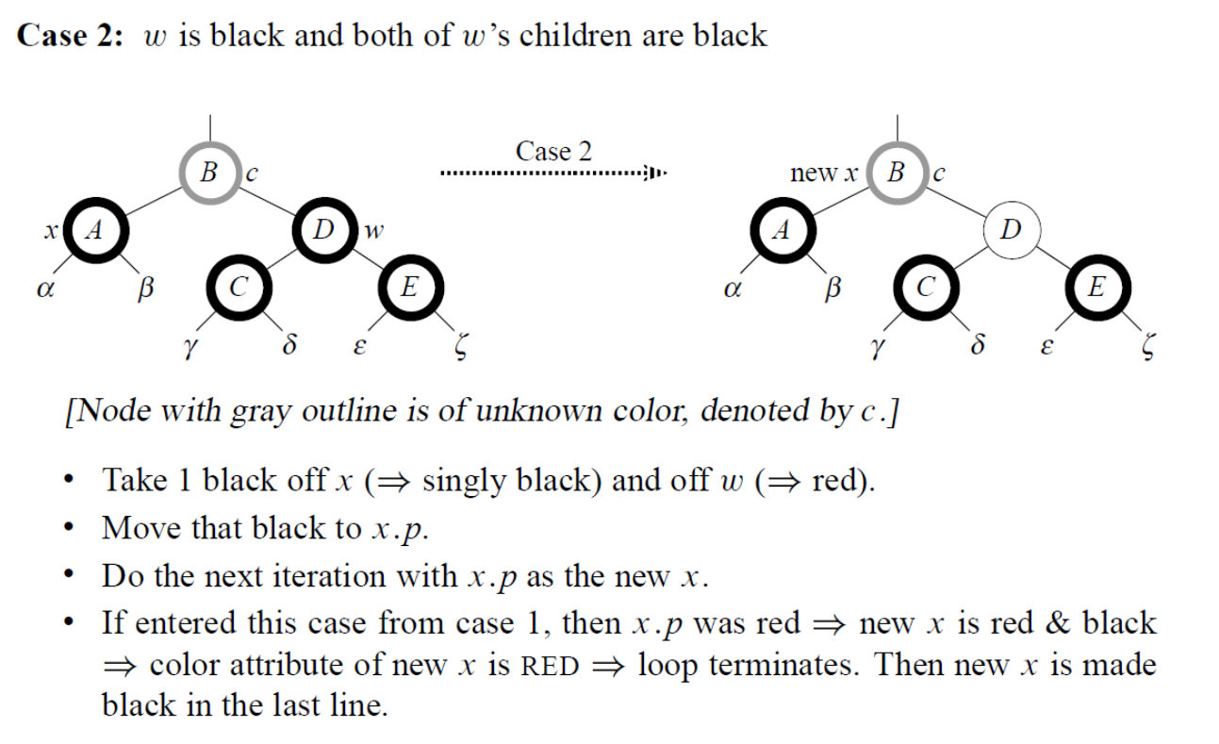
Case 2: Black sibling + 2 black children

Slide 32
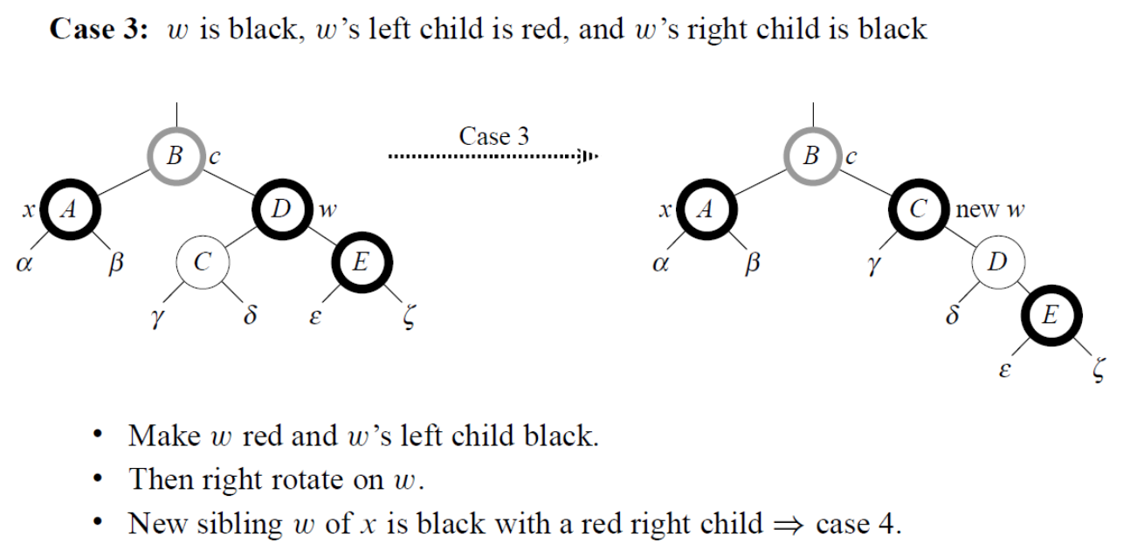
Case 3

Slide 33
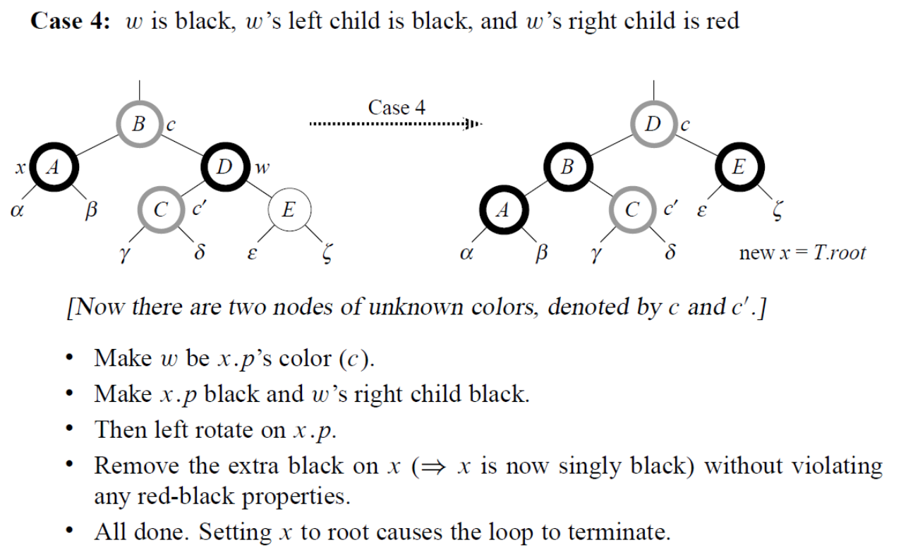
Case 4

Slide 34
Cases 5-8
Cases 1-4 happened when x was a left child
Cases 1-8 are symmetrical when x is a right child.

Slide 35
Interview Question
Suppose that a node x is inserted into a red-black tree with RB-INSERT and then is immediately deleted with RB-DELETE. Is the resulting red-black tree the same as the initial red-black tree? Justify your answer.
(answer in next slide)

Slide 36
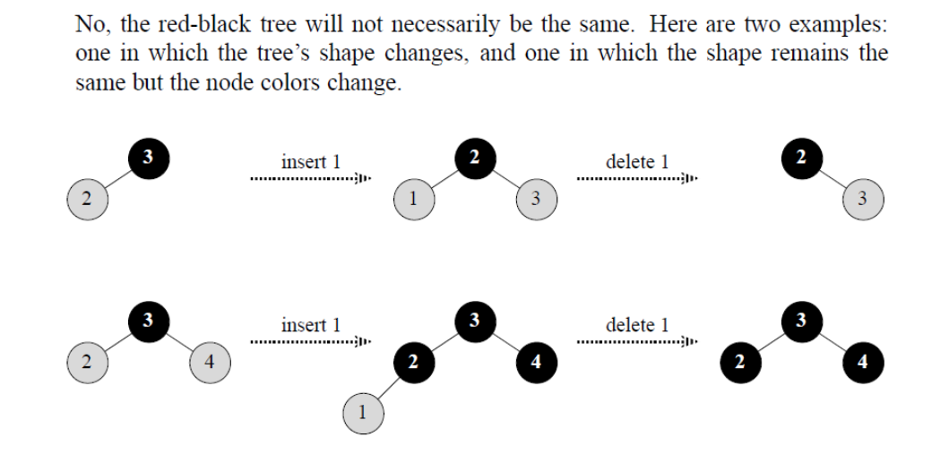
Solution

